Slide 1
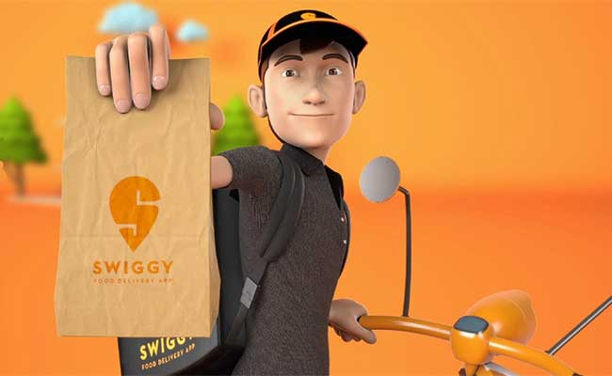
Analyzing Swiggy
Bangalore delivery outlet data
By
Mamta M. Natu

Slide 2
Introduction
Problem Statement
The online food ordering market includes foods prepared by restaurants, prepared by independent people, and groceries being ordered online and then picked up or delivered. The first online food ordering service, World Wide Waiter (now known as Waiter.com), was founded in 1995. Online food ordering is the process of ordering food from a website or other application. The product can be either ready-to-eat food or food that has not been specially prepared for direction consumption.

Slide 3
OBJECTIVES AND BENIFITS
1) Enhance Delivery Time and Cost-Effective
Data Science and analytics help them to optimize time and cost. So, if any circumstances occur, they know what to do and encourage them.
2) Evaluate customer behaviour
Big Data Analytics and Data Science are known for the data which can help them predict customer behavior.
3) Location-based Promotion
The benefit of Big Data Analytics is that it enables the food-tech company to target customers by creating use of real-time location and at the right time.

Slide 4
TASK
Do ETL : Extract-Transform-Load the dataset and find for me some information from this large data.
This is form of data mining.
What all information can be achieved by mining this data, would be explained in class by the trainer
Find key metrics and factors and show the meaningful relationships between attributes.
Do your own research and come up with your findings.

Slide 5
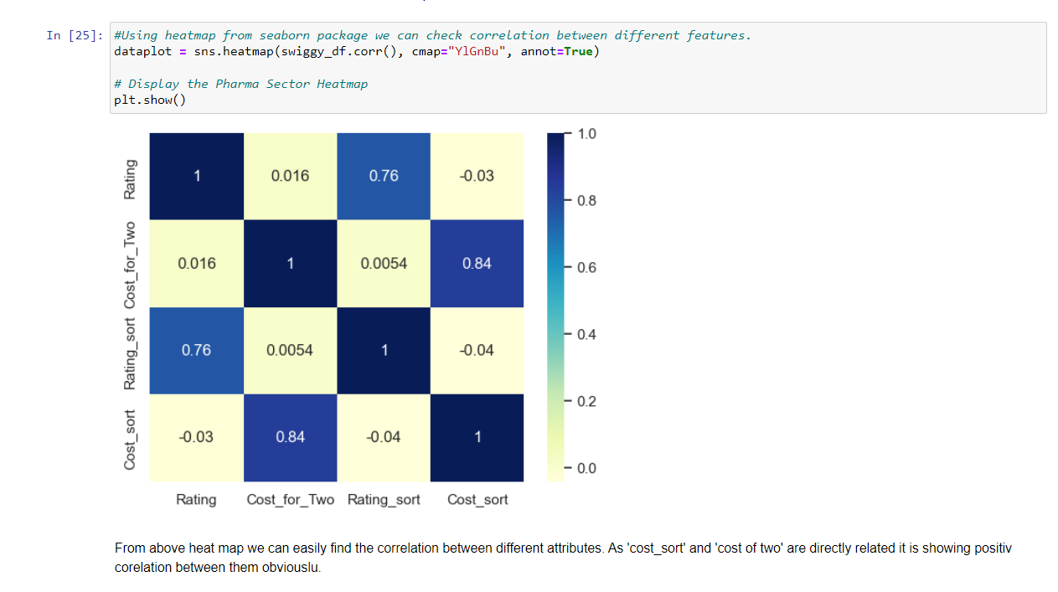
Finding correlation with Heatmap
As cost sort and cost for two are related columns they have positive correlation.
Similarly rate sort and rate are positively correlated.
But as we couldn't find any correlation between cost for two and rate.
Conclusion: ratings has no effect on cost for two persons.

Slide 6
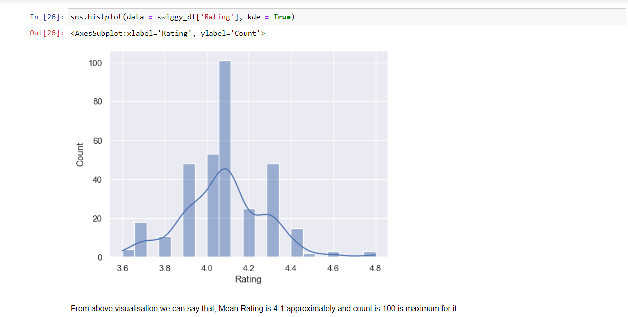
Distribution of rating count: Histplot
Histplot gives the distribution of count of ratings.
Ratings are normally distributed and mean is 4.1 approximately.
Highest count for 4.1 ratings is 100.
Conclusion: mean or average ratings of outlets is 4.1 approximately.

Slide 7
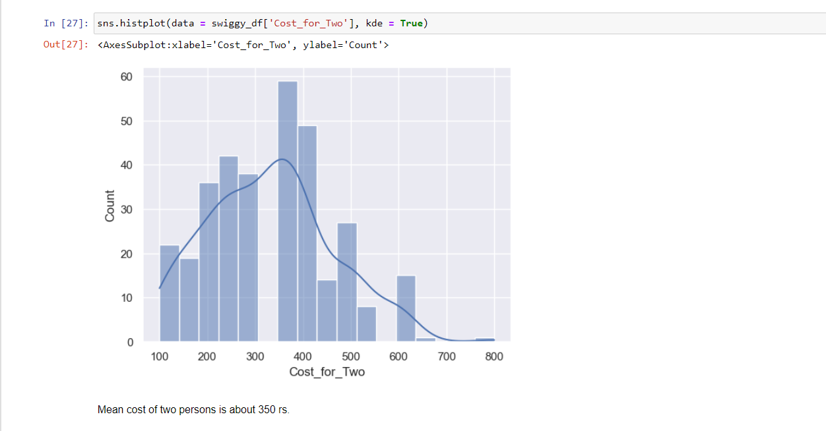
Distribution of cost for two: Histplot
Histplot gives the distribution of count of cost for two.
Cost for two are normally distributed and mean is Rs.350 approximately.
Conclusion: mean or average cost for two of outlets is Rs.350 approximately

Slide 8
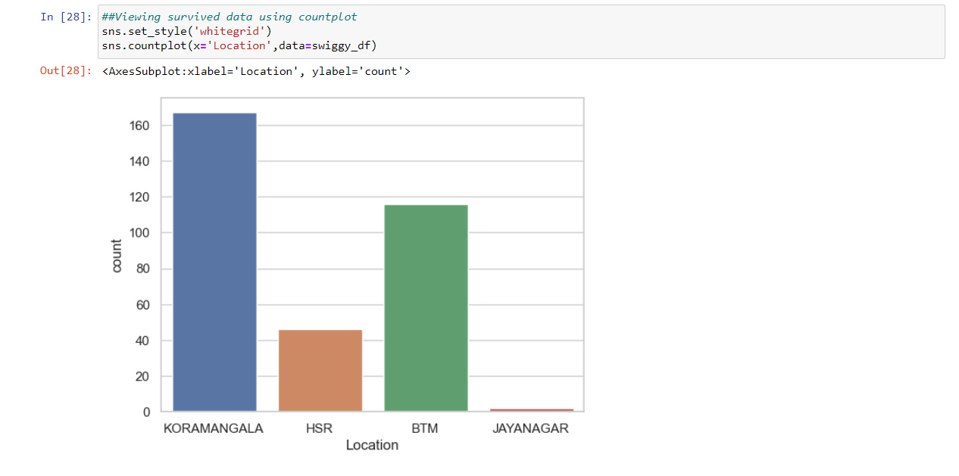
Distribution of Location: Count Plot
Count plot is used to show the distribution of count of cuisines over different location.
We can see here “Koramangala” has highest count of outlets.
And Jayanagara has least count of outlets.

Slide 9
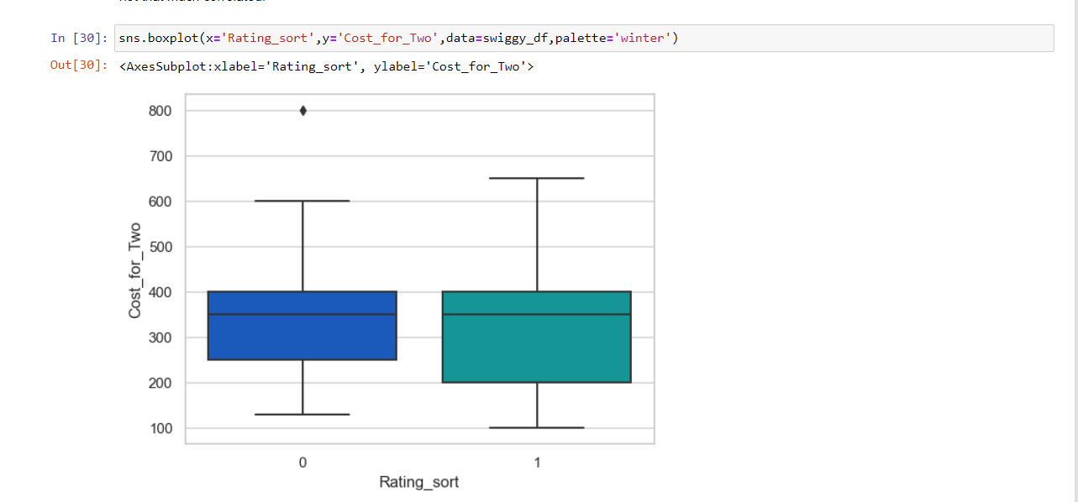
Rating sort Boxplot
1 show below avg. ratings
2 shows above avg. ratings
It gives Q1, Median,Q3 ,Q4 and outlier here.
Cost for two Rs. 800 is outlier here which is fall under below rating sort category.
Cost for two Rs. 350 is mean.
Conclusion: high cost doesn’t refer to high ratings always.

Slide 10
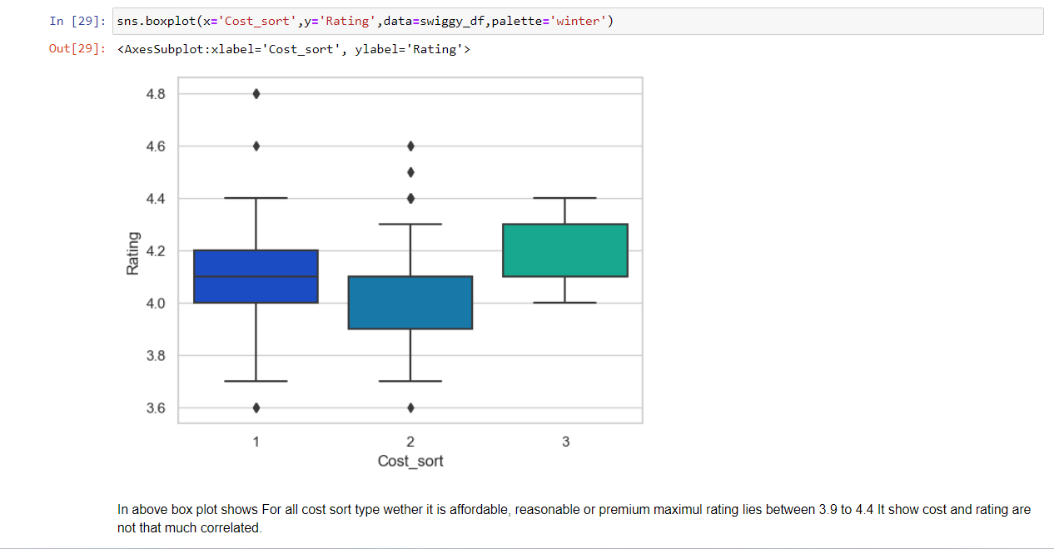
Cost for two Boxplot
1 show affordable food
2 shows reasonable food
3 shows premium food
Here 4.6 and 4.8 ratings are outliers.
Conclusion: Ratings between 3.9 to 4.2 are average for all three cost sort category.

Slide 11
Thank you

